Slide 1
Co-convener Presentation
Matt Clausen
Carolina Escobar
Public-Private Partnerships
- 15 minutes -
Focus on Partners Strategic Goal #1 - Increased Financial Sustainability
Learning through our experiences with new donors, collaborators and partners: Program design, contracts, budgets and implementation. What do new types of collaborators demand and how can we value our know-how, position Partners most effectively with them, and do so with the greatest potential for growth in both restricted and unrestricted revenue with the least risk?

Slide 2
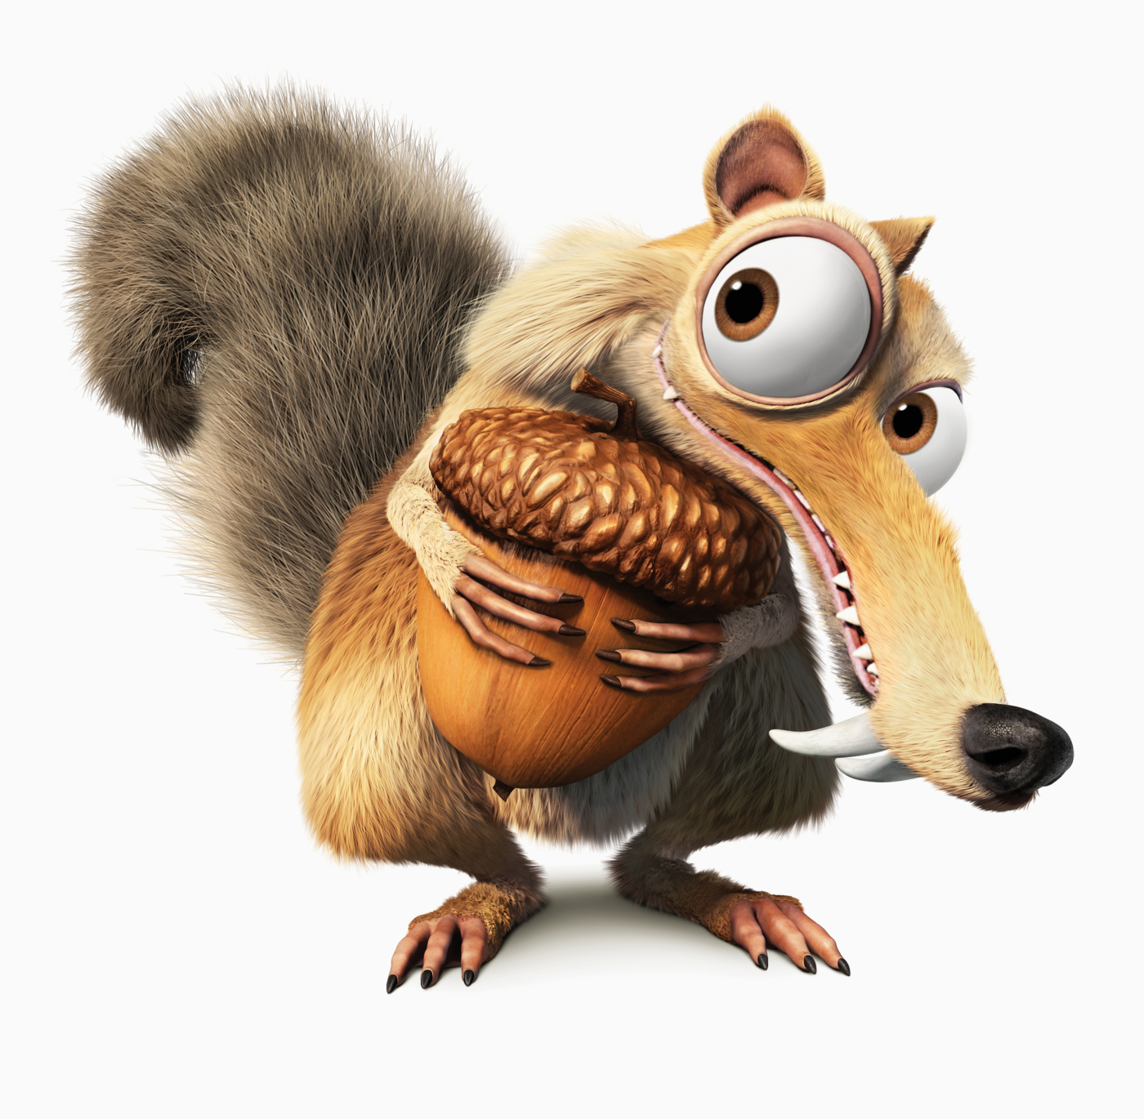
…Squirrel away…
…Protecting our acorns…
…Acorns budget stile…
Acorns are to Squirrels as
Knowledge/Experience
are to Partners
Experience
Expertise
Knowledge
Data/
Information
Objective facts about
Events /
Analysis/exchange of Data
ACTIVITIES
consequence of the information in people
STAFF/VOLUNTEERS
Knowledge develops over time and becomes EXPERTISE, CONTENT, CURRICULA, BOOKS…
Know-How ---> Leads to unrestricted profit

Slide 3
How do we Squirrel Away?
Donor Analysis (Traditional?, non traditional?, flexible budget, restricted budget?
We like flexible and non traditional organizations
We like organizations with program expansion potential
Consistency: What we Sell = What we Budget
Identify your know-How source
Value your Know-How
Know-How Protection
We budget contingencies, always
We track budget lines
We are aware of the environment (example: Currency exchange)
Build a long term relationship ---> To multiply and transfer the impact

